Slide 1
Capstone Project- 1
EDA on Airbnb booking
by-
Muhammad Waqar

Slide 2
What is Airbnb
Airbnb, as in “Air Bed and Breakfast,” is a service that lets property owners rent out their can rent a space for multiple people to spaces to travelers looking for a place to stay. Travelers share, a shared space with private rooms, or the entire property for themselves.

Slide 3

Problem Statement
For this project we are analyzing Airbnb’s New York City(NYC) data of 2019. NYC is not only the most famous city in the world but also top global destination for visitors drawn to its museums, entertainment, restaurants and commerce.
Our main objective is to ﬁnd out the key metrics that inﬂuence the listing of properties on the platform. For this, we will explore and visualize the dataset from Airbnb in NYC using basic exploratory data analysis (EDA) techniques.
Data analysis on thousands of listings provided through Airbnb is a crucial factor for the company.
We will be ﬁnding out the distribution of every Airbnb listing based on their location, including their price range, room type, listing name, and other related factors.

Slide 4

Understanding the Data
There are 49,000 observations with various types of field in our dataset.
List of field:
Id
Name
Host_id
Host_name
Neighbourhood_group
Neighbourhood
Latitude
Longitude
Room_type
Price
Minimum_nights
Number_of_reviews
Last_review
Reviews_per_month
Calculated_host_listing_count
availabilty_365

Slide 5

Agenda
We try to answer following questions for Airbnb:
What is the average preferred price by customers according to the location?
Number of active hosts per location (Where most of the hosts focused to own property?)
Where the customer pays the highest and lowest rent according to location?
Most popular/demanded host of Airbnb in New York
Find the total count of each room type

Slide 6

Agenda(Cont...)
Room types and their relation with availability in different neighbourhood groups?
Which are the top 25 most used words in listing names?
Find top 10 hosts with most listings
Find the top three hosts based on their turnover
Find total no. of nights spend per location
Total no. of nights spends per room types
Top 10 highest listing neighborhood

Slide 7
Map of New York City(NYC)

Slide 8
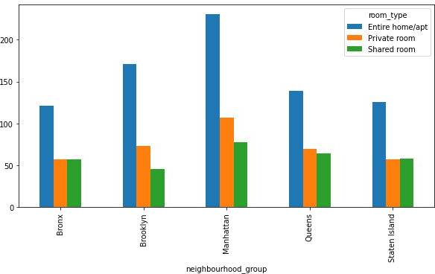
What is the average preferred price by customers according to the location?
As we can see in Manhattan average price of Entire home/apt is highest, compared to other location.
Average price of shared room is lowest in brooklyn.
Queens, Staten Island and Bronx share almost the same price i.e $50 for Shared room and Private room.

Slide 9
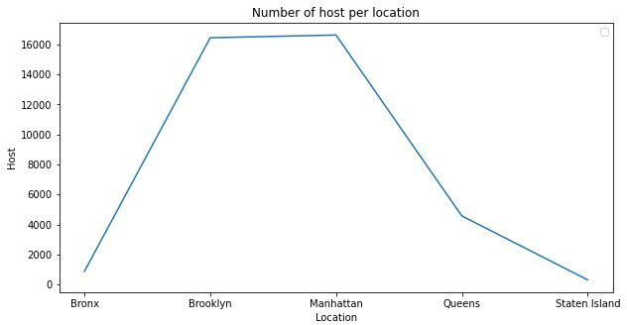
Number of active hosts per location (Where most of the hosts interested to own property?)
Manhattan and Brooklyn is the most preferred place by hosts.
Bronx and Staten Island is low traffic for host as compared to other location
Queens has a average number of host.

Slide 10
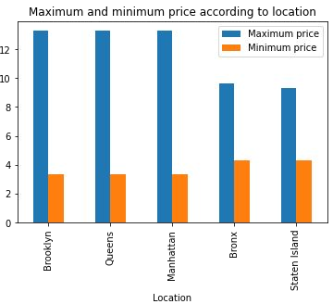
Where does the customers pay the highest and lowest rent according to location?
Maximum price of rent in Brooklyn, Queens, Manhattan is almost same.
Here we used log transformation to display minimum price with maximum price.
Minimum price in Brooklyn, Queens, Manhattan is also same.

Slide 11
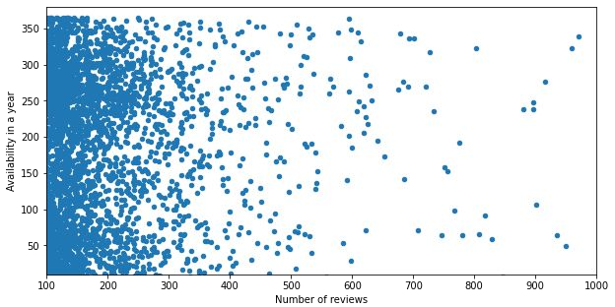
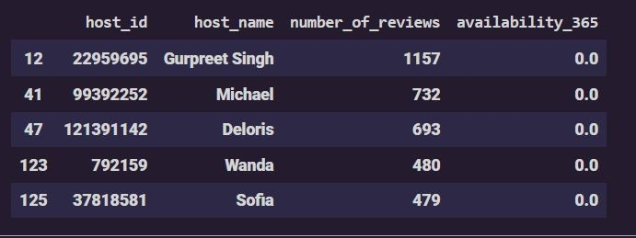
Most popular/demanded host of Airbnb in New York City
Here we used Scatter plot for displaying the most demanded host with respect to Number of reviews and availability in a year.
In the table below we have displayed top 5 hosts of Airbnb in New York City.

Slide 12
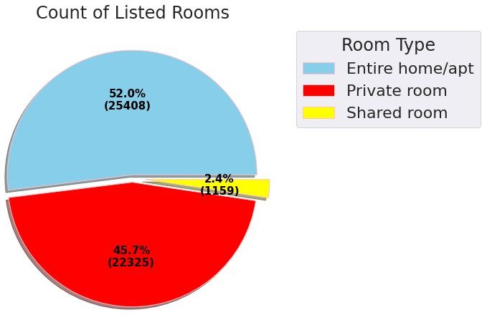
Total count of each room type as per listing.
Based on the Analysis we found that:
Entire home/apt has the highest number of listing of 52% among other room types.
Private room has 45.7% of listing among other room types.
Shared Room is the least listed room type at only 2.4% in total.

Slide 13
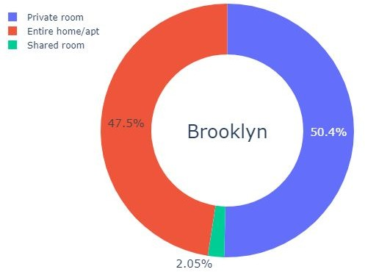
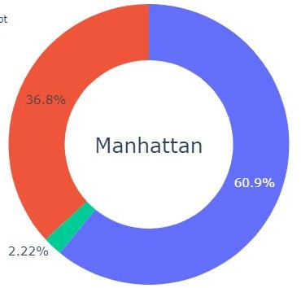
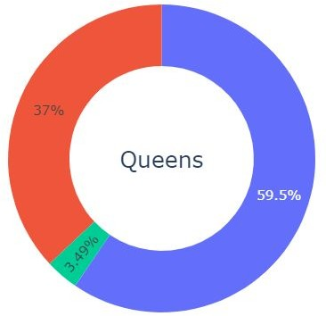
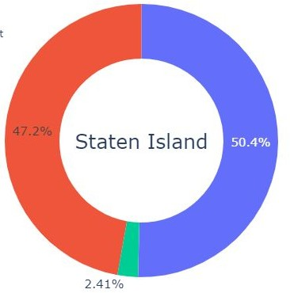
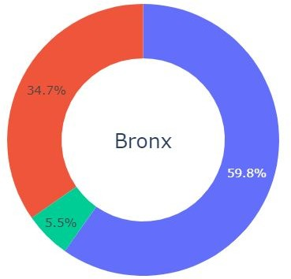
Room types and their relation with availability in different neighbourhood groups?
As we can see every neighbourhood group is dominated by the private room type at around 55%.

Slide 14
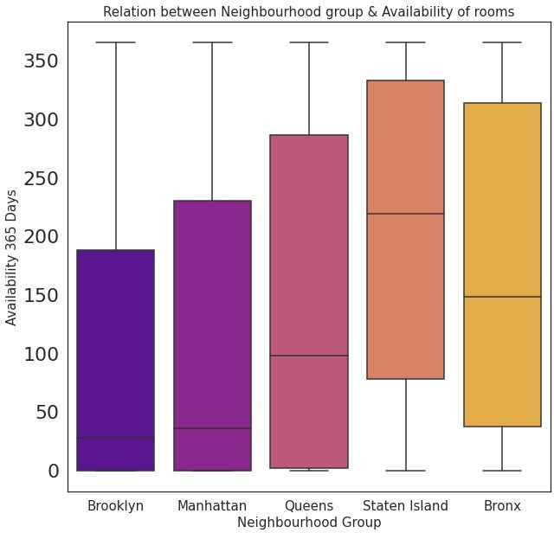
Room types and their relation with availability in different neighbourhood groups?(contd.)
❏ Brooklyn and Manhattan have the least availability of rooms overall, as low as 0 days.
❏ Staten Island and Bronx has the highest availability rate overall at around 300 days.
❏ Form this analysis we can say that people stay for longer duration of time in Private rooms in Brooklyn and Manhattan.

Slide 15
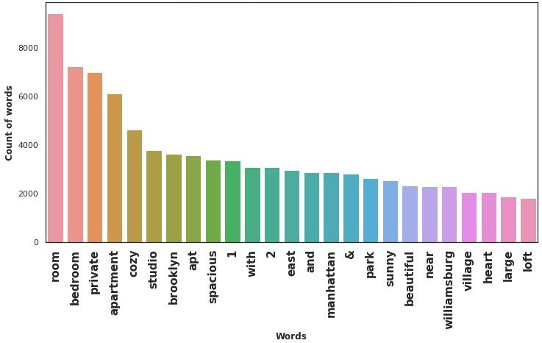
Top 25 most common words used in listing names

Slide 16
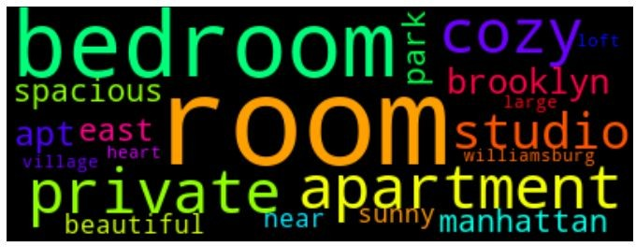
Top 25 most common words used in listing names (contd.)
❏ As we can see most of the listing names include words related to property type such as ‘bedroom’, ‘cozy’, ‘private’, ‘apartment’ and ‘spacious’.
❏ It is interesting to see that words related to proximity or connection to public places such as ‘park’, ‘near’, ‘village’ and ‘heart’ rank lower in chart.

Slide 17
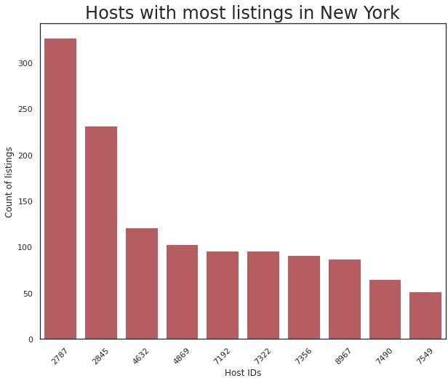
Top 10 hosts with most number of listings.
❏ From the chart, we can see that count of listing by top 10 hosts is almost 2.5%(1270 listings) of the whole dataset.
❏ Even one of the hosts has more than 300 listings!

Slide 18
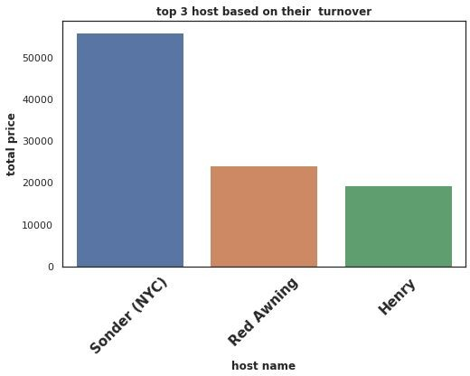
Top three hosts based on their turnover
Here we are trying to find top three host based on their turnover and compare between those three hosts.
We can state that Sonder(NYC) is the top host based on his high turnover.Red Awning and Henry secured 2nd and 3rd position respectively.
Total turnover of Sounder(NYC) is more than 50000$. Red Awning and Henry is quite behind from the 1st place.

Slide 19
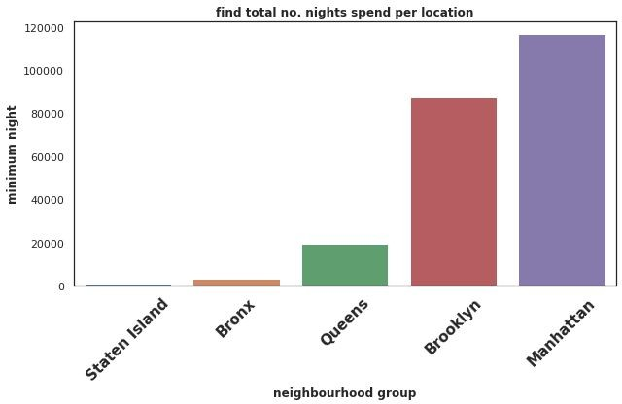
Find total no. nights spend as per location
The locations based
are on its total
categorized number of spend by
minimum customer.
nights
From here we can get an overall idea of which location the customer prefers more.
We can state that more customers prefer Manhattan and Brooklyn for night stay as compared to other locations.

Slide 20
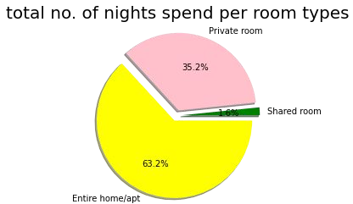
Total no. of nights spend per room types
Here we can state that in which room type customers prefer for night stay.
From pie chart we can conclude that 63.2% customers spend night in entire home/apt.
Only 1.6% customers spend night in shared room.

Slide 21
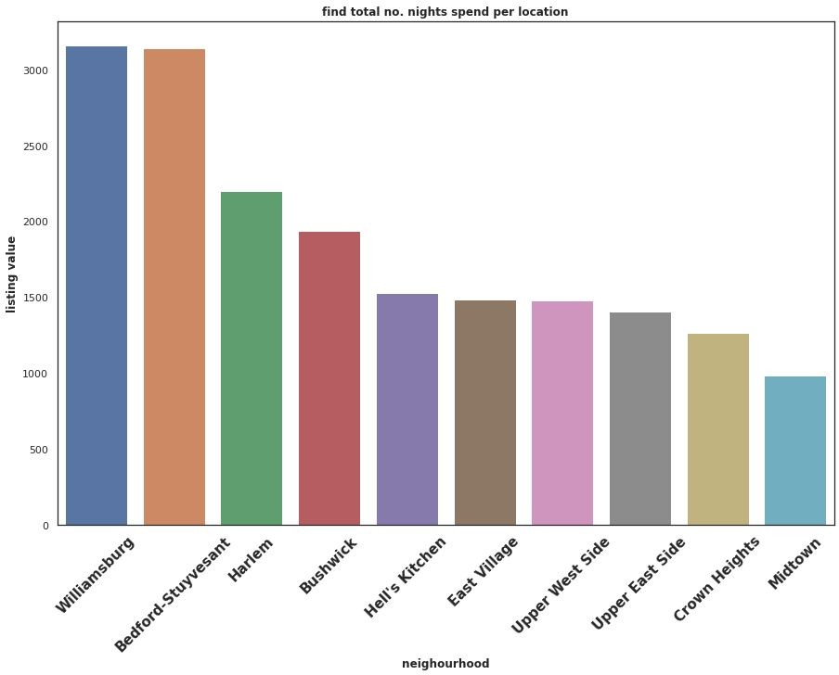
Top ten highest listing neighbourhood

Slide 22

Top ten highest listing neighbourhood(contd.)
Here we can state that Williamsburg has the highest listing.
And almost same in Bedford-Stuyvesant.
It’s a tourist attraction hence the number of listings could be higher.

Slide 23

Challenges Faced
Reading the dataset and understanding the meaning of some columns.
For answering some of the questions we had to understand the business model of airbnb that how they work.
Handling NaN values,null values and duplicates.
Designing multiple visualizations to summarize the information in the dataset and successfully communicate the results and trends to the reader.

Slide 24

We defined some points which can help airbnb in their business:
Analysis Summary:
Manhattan is the most focused place in New York for hosts to do their business
Customers pay highest amount in Brooklyn,Queens and Manhattan that is $10,000 and lowest amount is
$10.
For the three types of room type (i.e. Entire home, Shared room, & Private room) average price of entire home is around $157, for Shared room is around
$60, and for private room is around $75.
Top three host base on their turnover are Sonder(nyc),Red awning, Henry and best host is Sonder(nyc)

Slide 25

Analysis Summary (contd.):
‘Entire home/apt’ room type has the highest number of listing of 52% and ‘Shared Room’ is the least listed room type at only 2.4% in total.
People stay for longer duration of time in Private rooms in Brooklyn and Manhattan.
Words such as ‘bedroom’, ‘cozy’, ‘private’, ‘apartment’ and ‘spacious’ are used more frequently than words such as ‘park’, ‘near’, ‘village’ and ‘heart’.
Count of listing by top 10 hosts is almost 2.5% (1270 listings) of the whole dataset.
More customer preferred Manhattan location for night stay than Brooklyn
63.2% customer spend night in Entire home and 1.6% spend night in Shared room

Slide 26

Thank you

